Slide 1

Soil Digital Twin System for Smart Farming Applications Using IOT & ML
Soil Digital Twin System for Smart Farming Applications
by
T.YASWITHA
Roll No. 224G1A33C7
K.VARIJA
Roll No. 224G1A33C2
C.SREELATHA
Roll No. 224G1A33B1
C.REVATHI Roll No. 224G1A3381
Under the guidance of
Mr. LINGAM SUMAN ,M.Tech,(Ph.D)
Assistant Professor
Department of Computer Science and Engineering (AI & ML)
Srinivasa Ramanujan Institute of Technology
(Affiliated to JNTUA & Approved by AICTE) (Accredited by NAAC with ‘A’ Grade & Accredited by NBA (EEE, ECE & CSE)
Rotarypuram Village, B K Samudram Mandal, Ananthapuramu – 515701.
2025 - 2026
B-09
Srinivasa Ramanujan Institute of Technology

Slide 2
Contents
Soil Digital Twin System for Smart Farming Applications
• Abstract
• Introduction
• Problem Statement
• Objectives of Project
• Methodology
Proposed System
• Implementation Details
• Expected Outcomes
•Budget Estimation
B-09
Srinivasa Ramanujan Institute of Technology
2

Slide 3
Abstract
Soil Digital Twin System for Smart Farming Applications
Problem Statement:
Conventional soil monitoring systems use many sensors across the field, increasing cost, maintenance, and energy usage. They provide only real-time data, requiring farmers to manually interpret soil conditions, which may lead to inefficient water and soil management.
Monitor soil moisture and temperature using limited sensors at base points
Develop a Soil Digital Twin to represent actual soil conditions
Model soil behavior using ML and historical data
Reduce sensor deployment cost while maintaining reliable monitoring
IoT sensors placed at selected base points collect soil parameters, which are mapped to a virtual soil model (Digital Twin). The Digital Twin reflects current soil conditions and helps understand soil behavior efficiently using AI, enabling scalable and cost-effective smart farming.
Keywords:
Soil Digital Twin, Smart Agriculture, IoT, Soil Monitoring, ML,Moisture, Automated Irrigation , Sustainable Farming
B-09
Srinivasa Ramanujan Institute of Technology

Slide 4
Introduction
Soil Digital Twin System for Smart Farming Applications
Soil quality and effective soil management play a vital role in agricultural productivity, water conservation, and sustainable farming practices. However, many farmers still depend on manual observation to decide irrigation, seeding, and mulching activities. This often leads to inefficient water usage, uneven seed germination, and unnecessary mulching, resulting in increased costs and reduced farming efficiency.
This project presents an ML-based Soil Digital Twin System using IoT sensors to support data-driven soil monitoring and management. Sensors placed at selected base points continuously measure key soil parameters such as soil moisture and soil temperature. These sensor readings are used to update a virtual soil model (Digital Twin) that represents the actual soil condition of the field.
Based on the current soil state represented by the Digital Twin, the system helps in understanding soil conditions for effective irrigation, seeding, and mulching decisions. By reducing dependency on dense sensor deployment and manual estimation, the proposed system improves resource utilization, enhances crop growth, and supports sustainable and cost-effective farming practices.
B-09
Srinivasa Ramanujan Institute of Technology

Slide 5
Problem Statement
Soil Digital Twin System for Smart Farming Applications
Soil health plays a critical role in determining crop productivity, water utilization efficiency, and overall agricultural sustainability. However, traditional soil monitoring practices rely heavily on manual sampling and laboratory testing, which are time-consuming, costly, and incapable of providing real-time insights. Farmers often make irrigation and fertilization decisions based on experience or visual observation rather than accurate soil condition data. This can result in over-irrigation, nutrient imbalance, reduced crop yield, and unnecessary resource wastage.
Moreover, soil parameters such as moisture, pH, temperature, and humidity vary dynamically due to changing environmental conditions. Continuous monitoring of large agricultural fields is difficult using conventional methods, making it challenging to detect stress conditions at an early stage. Lack of timely and data-driven decision support limits the adoption of precision agriculture practices, especially in small and medium-scale farms.
Therefore, there is a need for an intelligent, real-time monitoring and decision-support system that can continuously track soil conditions, analyze trends, and provide predictive recommendations for irrigation and soil management. The proposed Soil Digital Twin System for Smart Farming Applications using IoT and Machine Learning aims to create a virtual replica of the physical soil environment, enabling data-driven irrigation control, efficient resource utilization, and sustainable agricultural practices. This system supports precision farming by integrating IoT-based sensing, cloud connectivity, and machine learning-driven analytics to improve crop health, reduce water wastage, and enhance overall farm productivity.
B-09
Srinivasa Ramanujan Institute of Technology

Slide 6
Objectives:
Soil Digital Twin System for Smart Farming Applications
Efficient Soil Monitoring: Monitor soil moisture and temperature using sensors placed at selected base points instead of dense sensor deployment.
Soil Digital Twin Development: Create a virtual soil model that accurately represents real soil conditions using sensor inputs.
AI-Based Soil Modeling: Use AI techniques to understand soil behavior based on historical and current sensor data.
Cost-Effective System Design: Reduce hardware, maintenance, and energy costs by minimizing the number of sensors required.
Scalable Smart Agriculture Solution: Enable reliable soil monitoring and management that can be easily scaled to larger agricultural fields.
B-09
Srinivasa Ramanujan Institute of Technology

Slide 7
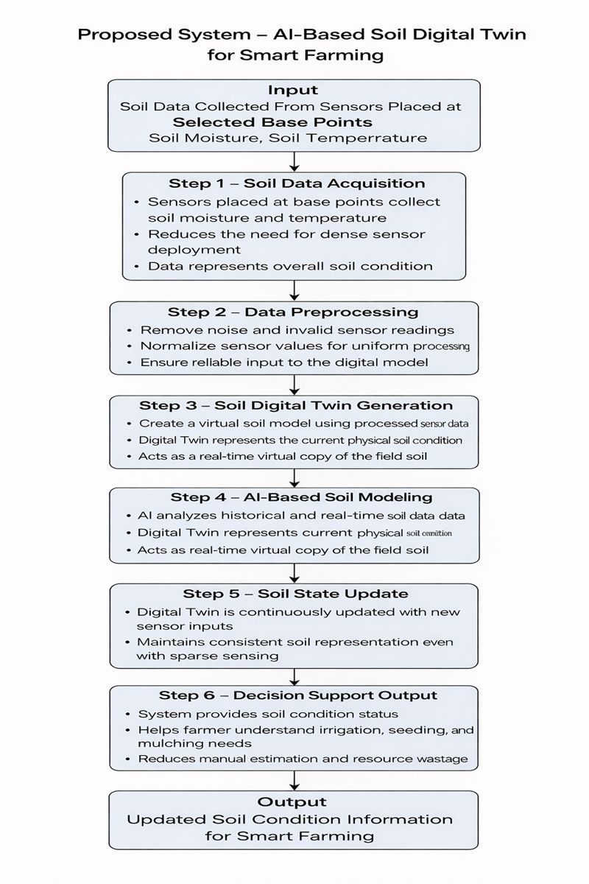
Proposed System
Soil Digital Twin System for Smart Farming Applications
B-09
Srinivasa Ramanujan Institute of Technology

Slide 8
Methodology
Soil Digital Twin System for Smart Farming Applications
The Soil Digital Twin System begins its operation by initializing all hardware components including soil moisture sensors, pH sensor, temperature sensor, humidity sensor, NodeMCU/ESP8266 microcontroller, power supply unit, and Wi-Fi connectivity module. Proper calibration of sensors is performed to ensure accurate measurement of soil parameters. The microcontroller establishes communication with the cloud server for real-time data transmission and storage.
As the sensors collect real-time soil data, the microcontroller preprocesses the readings by filtering noise and removing outliers. The processed data is transmitted to a cloud-based platform where it is stored and visualized through a web dashboard. The Digital Twin model creates a virtual replica of the physical soil environment by continuously synchronizing real-world sensor data with the cloud database.
Machine Learning algorithms are applied to analyze soil trends, detect abnormal conditions, and predict irrigation requirements. Based on threshold values and predictive outputs, automated irrigation control signals can be generated. If soil moisture falls below the defined limit, the irrigation system is activated; otherwise, the system remains idle.
This integrated process ensures continuous monitoring, predictive soil analysis, efficient irrigation management, and real-time decision support for farmers.
B-09
Srinivasa Ramanujan Institute of Technology

Slide 9
Implementation Details
Soil Digital Twin System for Smart Farming Applications
The Soil Digital Twin System is implemented using an IoT-based architecture integrated with Machine Learning analytics. Soil parameters such as moisture, pH, temperature, and humidity are collected using calibrated sensors connected to a NodeMCU microcontroller. The sensor data is transmitted to a cloud platform via Wi-Fi for storage and processing.
A web-based dashboard is developed to visualize real-time soil conditions, historical trends, and irrigation status. The Digital Twin model continuously updates the virtual soil representation based on incoming sensor data.
Machine Learning models such as regression or classification algorithms are implemented to predict soil moisture levels and recommend irrigation scheduling. The system achieves reliable prediction accuracy by training the model on collected soil datasets. Based on prediction results, automated irrigation control is implemented using a relay module connected to a water pump.
Cloud integration enables remote monitoring and control, allowing farmers to access soil data through a web interface. The system ensures seamless coordination between hardware (sensors and irrigation system) and software (cloud database, ML model, and visualization dashboard).
B-09
Srinivasa Ramanujan Institute of Technology

Slide 10
Expected Outcomes
Soil Digital Twin System for Smart Farming Applications
The expected outcome of this project is the successful development of a Soil Digital Twin System capable of continuously monitoring soil parameters in real time. The system should accurately collect and transmit soil moisture, pH, temperature, and humidity data to the cloud platform.
The Digital Twin dashboard will display real-time soil conditions, historical data trends, and predictive analytics results. The Machine Learning model is expected to predict irrigation requirements with high reliability based on soil conditions and past data patterns.
When soil moisture falls below the defined threshold, the system will automatically activate irrigation through a relay-controlled pump mechanism. This ensures efficient water usage and prevents over-irrigation.
Overall, the system aims to improve crop yield, reduce water wastage, minimize manual monitoring efforts, and promote sustainable precision farming practices through IoT-enabled real-time monitoring and intelligent decision support.
B-09
Srinivasa Ramanujan Institute of Technology

Slide 11
COMPONENTS
Soil Digital Twin System for Smart Farming Applications
Hardware Components
NodeMCU (ESP8266 Wi-Fi Module)
Arduino UNO
Soil Moisture Sensor
pH Sensor (Serial Output)
DHT11 Temperature & Humidity Sensor
LCD Display (16×2)
Relay Module (5V)
AC Water Pump Motors (2)
5V Power Supply
12V 1A Adapter
Connectors, Jumper Wires & Plugs
PCB / Breadboard & Circuit Assembly
Protective Enclosure & Mounting Frame
Software & Cloud Components
Web Application Development Platform
Cloud Hosting & Database Services
Domain Registration & Deployment Services
APIs / Data Visualization Tools
Software Testing & Maintenance Tools
B-09
Srinivasa Ramanujan Institute of Technology

Slide 12
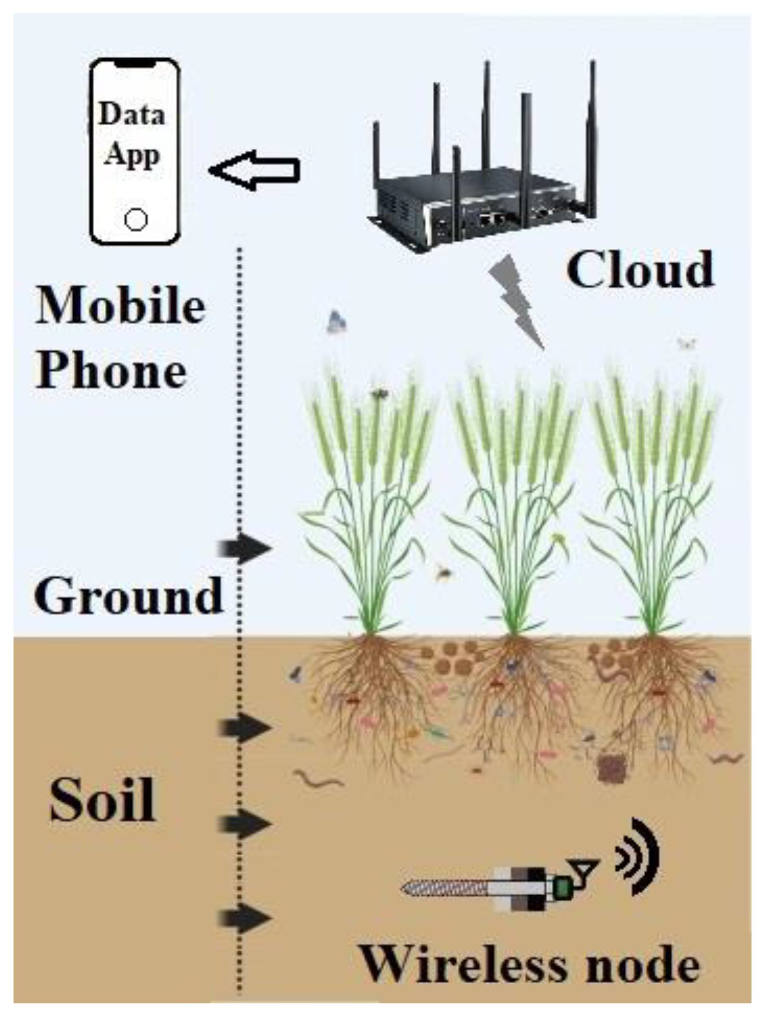
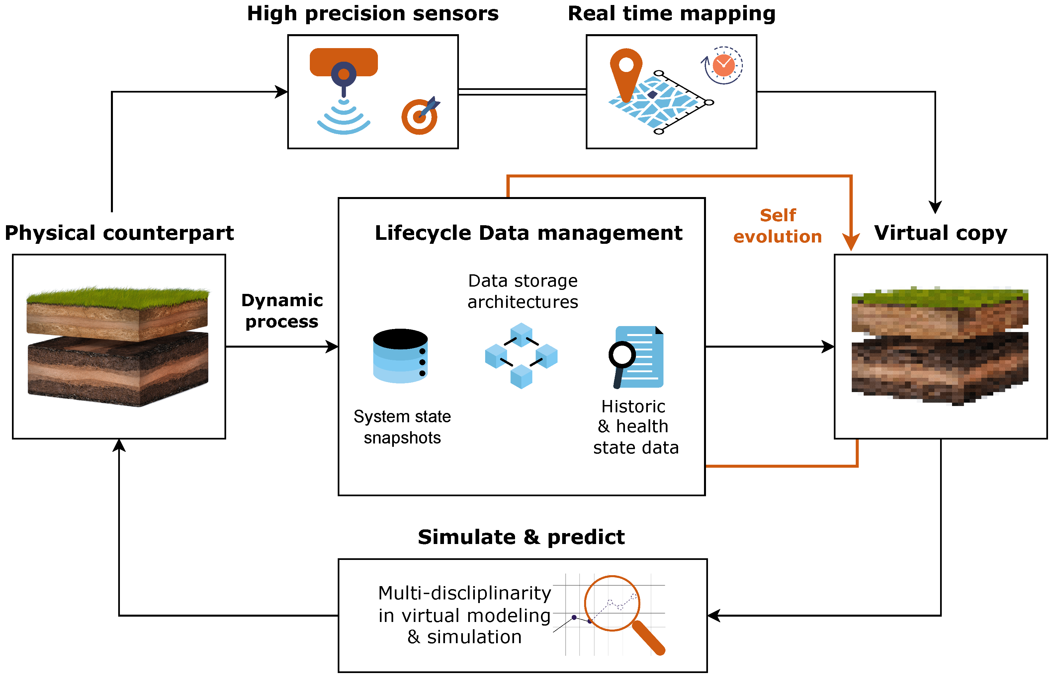
BLOCK DIAGRAM
Soil Digital Twin System for Smart Farming Applications
B-09
Srinivasa Ramanujan Institute of Technology

Slide 13
Non – Recuring Budget Estimation
Soil Digital Twin System for Smart Farming Applications
S. No | Item Head | Estimated Cost (Rs.) | Fund Arranged by Students (Rs.) | Fund Required from Institute (Rs.)
1 | NodeMCU (ESP8266 Wi-Fi Module) | 600 | 300 | 300
2 | Arduino UNO | 900 | 450 | 450
3 | Soil Moisture Sensor | 400 | 200 | 200
4 | pH Sensor (Serial Output) | 2,500 | 1,250 | 1,250
5 | DHT11 Temperature & Humidity Sensor | 250 | 125 | 125
6 | LCD Display (16×2) | 400 | 200 | 200
7 | Relay Module (5V) | 250 | 125 | 125
8 | AC Water Pump Motors (2) | 1,800 | 900 | 900
9 | 5V Power Supply | 350 | 175 | 175
10 | 12V 1A Adapter | 450 | 225 | 225
11 | Connectors, Jumper Wires & Plugs | 600 | 300 | 300
12 | PCB / Breadboard & Circuit Assembly | 500 | 250 | 250
13 | Protective Enclosure & Mounting Frame | 1,100 | 550 | 550
Subtotal |  | 11,500 | 5,750 | 5,750
B-09
Srinivasa Ramanujan Institute of Technology

Slide 14
Recurring Budget Estimation
Soil Digital Twin System for Smart Farming Applications
S. No | Item Head | Estimated Cost (Rs.) | Fund Arranged (Rs.) | Fund Required (Rs.)
1 | Web Application Development | 3,000 | 1,500 | 1,500
2 | Cloud Hosting & Database Services | 1,500 | 750 | 750
3 | Domain Registration & Deployment | 700 | 350 | 350
4 | APIs / Data Visualization Tools | 800 | 400 | 400
5 | Software Testing & Maintenance | 1,000 | 500 | 500
Subtotal |  | 7,000 | 3,500 | 3,500
B-09
Srinivasa Ramanujan Institute of Technology

Slide 15
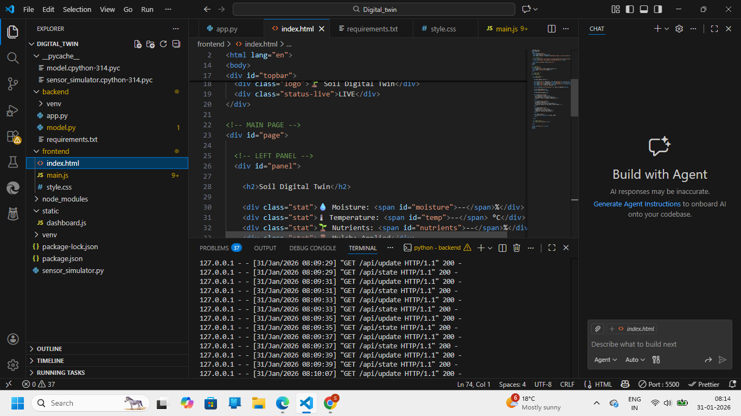
Sample code
Soil Digital Twin System for Smart Farming Applications
B-09
Srinivasa Ramanujan Institute of Technology

Slide 16
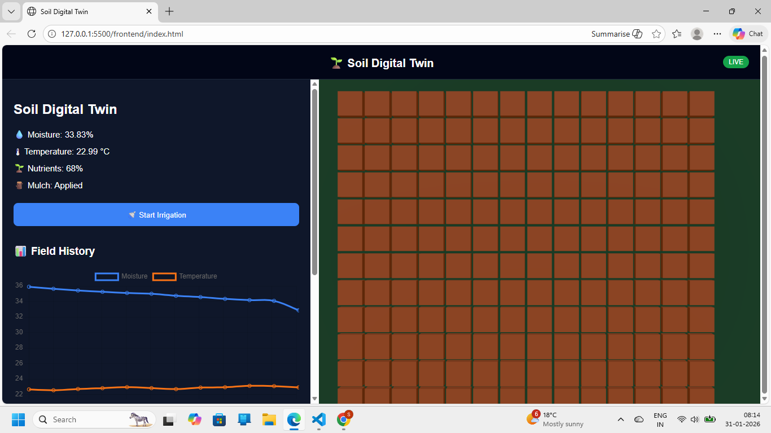
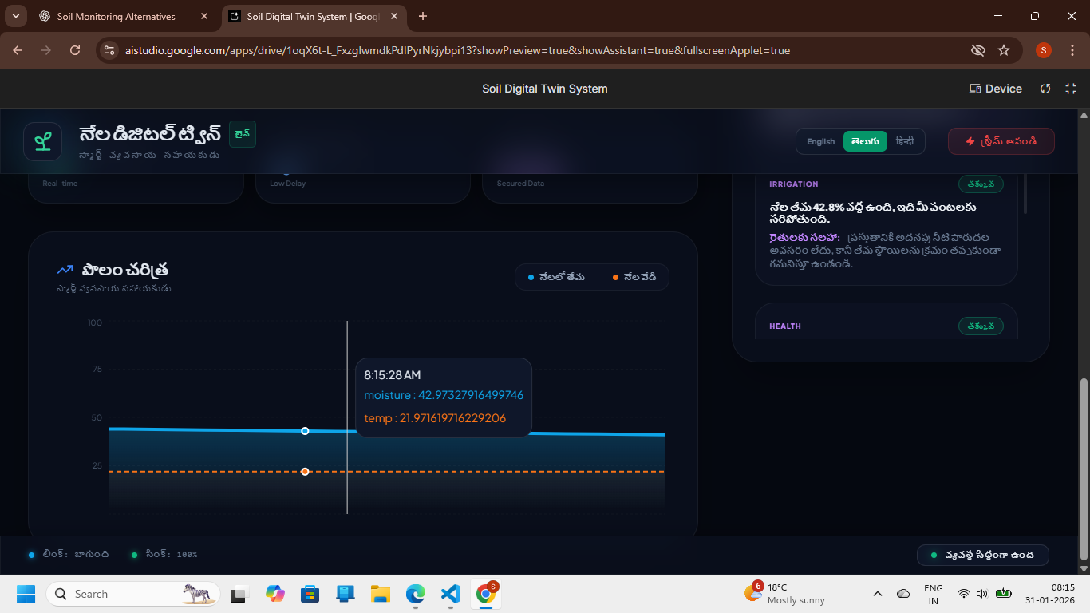
Project Execution Screenshots
Soil Digital Twin System for Smart Farming Applications
B-09
Srinivasa Ramanujan Institute of Technology

Slide 17
Reference
Soil Digital Twin System for Smart Farming Applications
1. Patil, K. A., & Kale, N. R., “A Model for Smart Agriculture Using IoT,” International Conference on Global
Trends in Signal Processing, Information Computing and Communication, IEEE, 2016.
2. Ray, P. P., “Internet of Things for Smart Agriculture: Technologies, Practices and Future Direction,” Journal of
Ambient Intelligence and Smart Environments, 2017.
3. Zhang, Y., Wang, G., Wang, J., & Liu, X., “Digital Twin-Based Smart Agriculture: Framework and Key
Technologies,” IEEE Access, 2021.
4. FAO, The Future of Food and Agriculture – Trends and Challenges, Food and Agriculture Organization of the
United Nations, 2017.
5. Reddy, K. J., & Kumar, M., “Machine Learning Techniques for Soil Moisture Prediction,” International Journal of
Advanced Research in Computer Science, 2020.
B-09
Srinivasa Ramanujan Institute of Technology

Slide 18
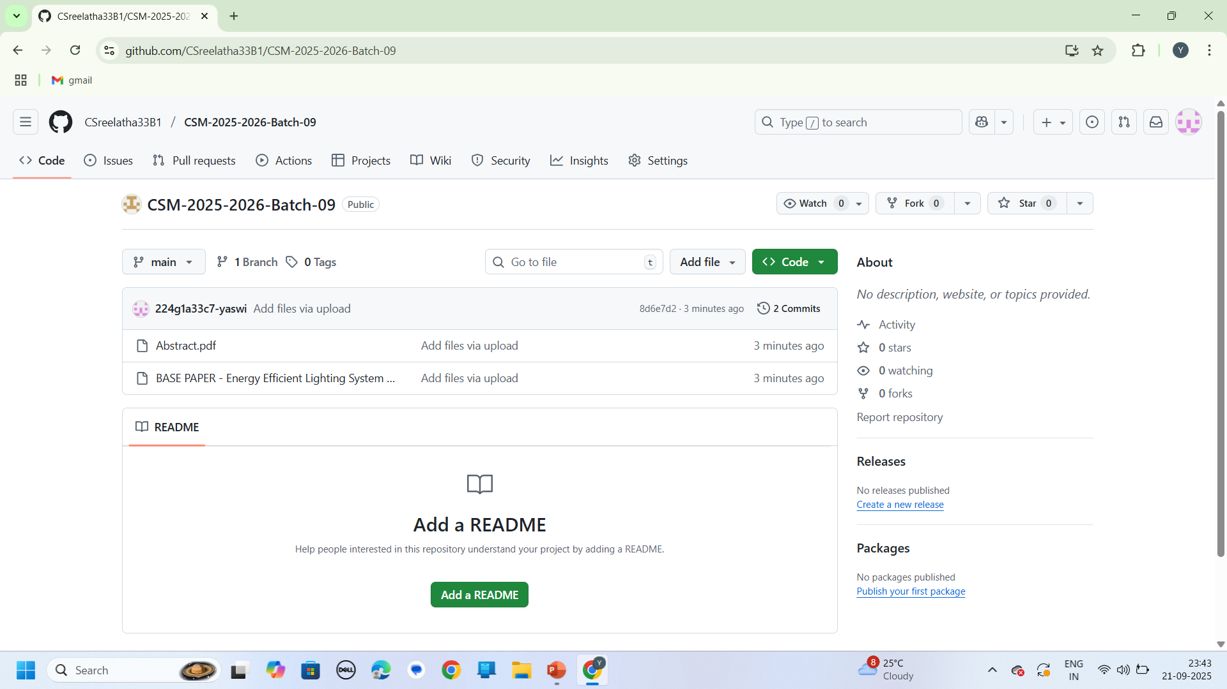
Github link
Soil Digital Twin System for Smart Farming Applications
B-09
Srinivasa Ramanujan Institute of Technology

Slide 19
Any Queries?
Soil Digital Twin System for Smart Farming Applications
B-09
Srinivasa Ramanujan Institute of Technology

Slide 20
Thank You!!!
Soil Digital Twin System for Smart Farming Applications
B-09
Srinivasa Ramanujan Institute of Technology

